Slide 1
모듈신경망을
활용한 열차 인식모델
최영조

Slide 2
CNN structure
SVM principal
Combining CNN and one class SVM
목차
FCN principal
Flows of Images in Combined Structure
Extract Features from an Image
Extract Features from Many Images

Slide 3





Scheme about Memory system
Meta-coginition
Handling
Upload
perception
Traversal
Information
Sensory
Memory
Working
Memory
Long-term
memory
illusion

Slide 4
Concept : imitating memory system
MC
SVM
Meta-coginition
Handling
Upload
perception
Pre
processing
OC
SVM
CNN
Traversal
Information
Sensory
Memory
Working
Memory
Long-term
memory
illusion

Slide 5
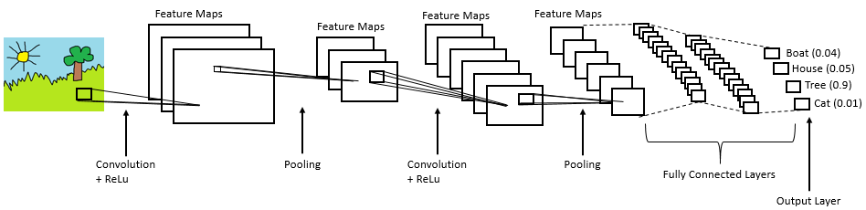
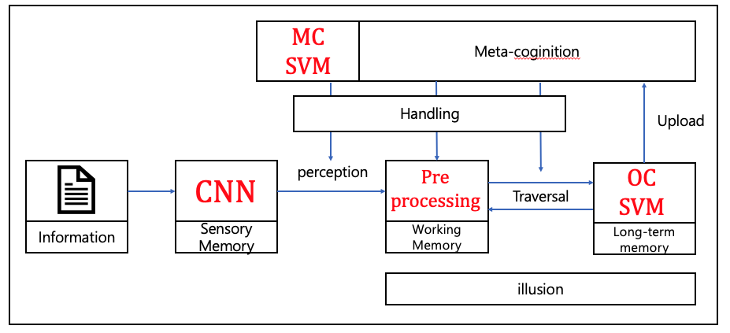
CNN structure
A feature for class 1
A feature for class 2
Return max value of class in softmax function
A feature for class 3
A feature for class 4

Slide 6

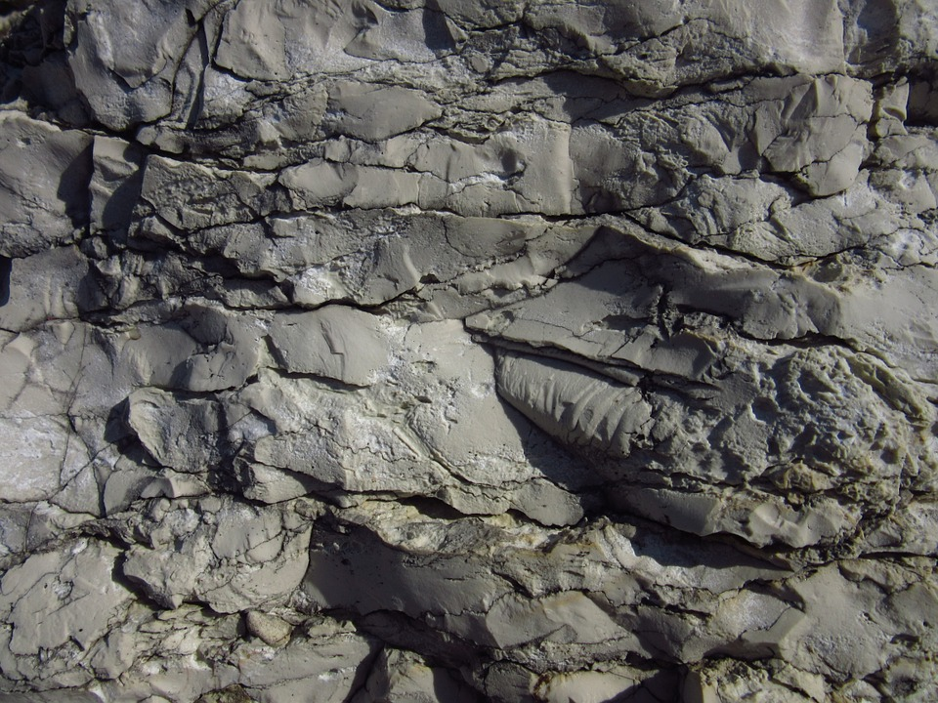

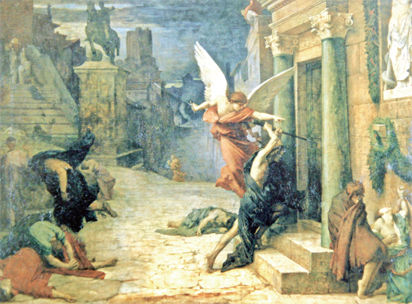
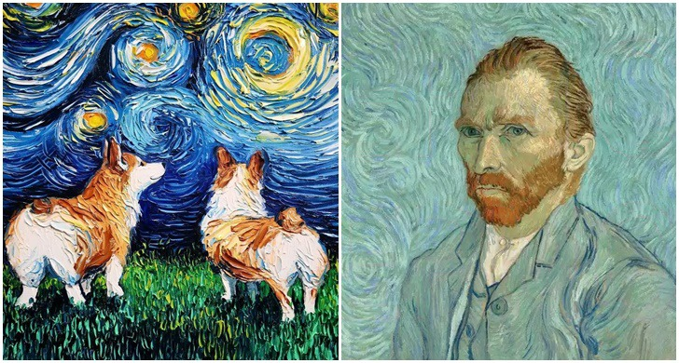
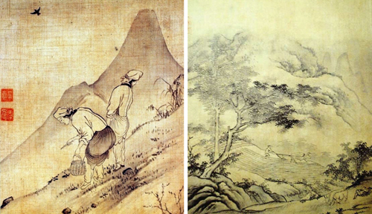
Implement : Sensory memory
Geometric
Color
23 classes
Low-dimension res
Texture
Painting style

Slide 7
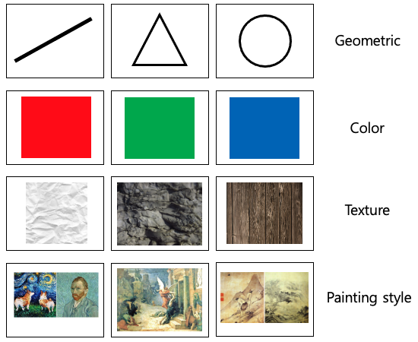

CNN structure
A feature for class 1
A feature for class 2
Return max value of class in softmax function
A feature for class 3
A feature for class 4
Artificial visual perceptron
C
N
N
Train

Slide 8
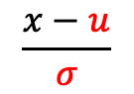
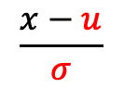
Feature vector preprocessing
A feature for class 1
A feature for class 2
A feature for class 3
A feature for class 4
[Train] Save mu & sigma
4.3
2.2
-7
0.2
0.8
8.1
$$\frac{x−u}{σ}$$
[Test] Apply norm
1
2
3
4
5
23
0.1
0.1
-2.1
-0.2
-0.3
1.4
$$\frac{x−u}{σ}$$
1
2
3
4
5
23
1
2
3
4
5
23
0.2
-0.2
-2.5
-0.7
-0.5
1.2

Slide 9
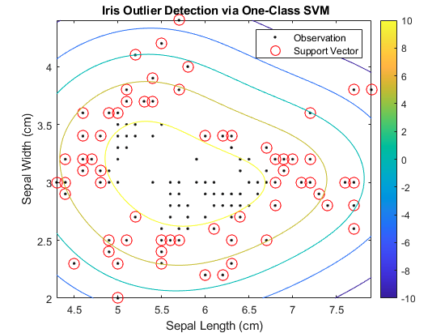
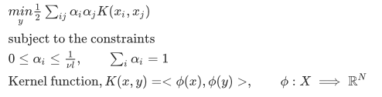
One class SVM principal
Positive or Outlier
When we haven’t negative data
If there are various of types in negative
Solving the OCSVM optimization problem :

Slide 10
One class SVM for Train appearance
Train
KTX images
Feature vectors
OCSVM
KTX SVM
ITX images
Feature vectors
OCSVM
ITX SVM
SRT images
Feature vectors
OCSVM
SRT SVM
TGV images
Feature vectors
OCSVM
TGV SVM
CRH images
Feature vectors
OCSVM
CRH SVM
RailJet images
Feature vectors
OCSVM
RailJet SVM
n images
Feature vectors
OCSVM
n SVM

Slide 11
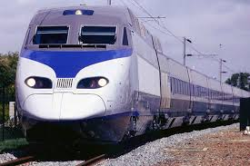
One class SVM for Train appearance
2.8914
KTX SVM
Test
3.0687
ITX SVM
C
N
N
Normalized
Feature vector
-0.5596
SRT SVM
4.6376
TGV SVM
3.8965
CRH SVM
-0.6893
RailJet SVM

Slide 12
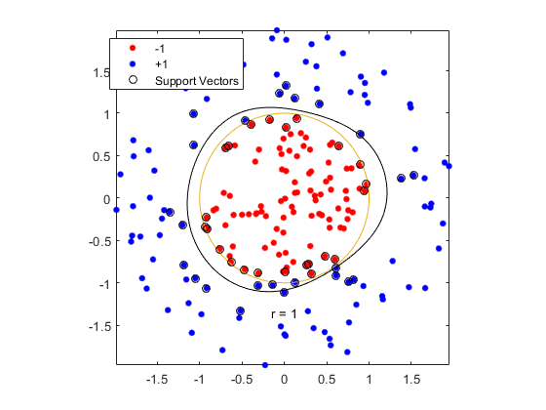
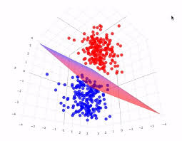
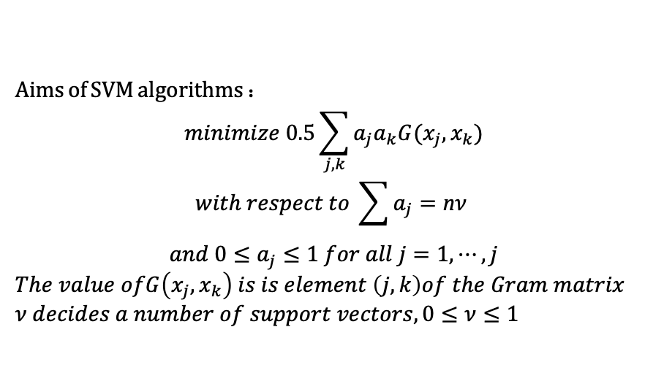
SVM principal
Similarity evaluation
Aims of SVM algorithms :
$$minimize 0.5\sum_{j,k}{a_{j}a_{k}G(x_{j},x_{k})}$$
$$with respect to \sum{a_{j}=\text{n}ν }$$
$$and 0≤a_{j}≤1 for all j=1,⋯,j$$
$The value ofG\left(x_{j},x_{k}\right) is is element \left(j,k\right)of the Gram matrix$
$ν decides a number of support vectors, 0≤ν≤1$
Get a point

Slide 13
Multi class SVM classifier
2.8914
KTX SVM
Test
3.0687
ITX SVM
C
N
N
Normalized
Feature vector
-0.5596
SRT SVM
4.6376
TGV SVM
3.8965
CRH SVM
-0.6893
RailJet SVM

Slide 14
Multi class SVM classifier
KTX cases
0.8083
3.4084
1.6541
4.7593
5.8814
2.1709
3.2494
-0.4823
5.0702
2.7111
-0.3165
1.1119
0.2092
1.9130
1.9608
0.4946
2.0091
-0.2656
1.6901
0.9916
-1.6635
-1.2874
-1.4319
-0.2514
-1.7352
-1.6298
-1.3183
-1.8677
-1.0424
-1.8457
-1.0495
-0.7777
-1.1002
-0.4854
-0.4248
-1.0652
-0.6822
-1.1992
-0.7854
-0.9117
2.1168
0.0375
-0.6794
0.8173
0.4401
-0.5303
0.3132
-1.2337
0.3673
-0.5560
-1.2295
1.8667
1.9316
3.6858
2.1789
1.7039
2.5922
0.4136
2.6431
1.6810

Slide 15
Multi class SVM classifier
ITX cases
0.7027
1.4990
-0.7491
3.8032
-1.9592
-1.0664
4.7330
-2.7239
3.3183
1.6294
-0.9107
-0.3112
-1.1637
0.7621
-1.3467
-1.1253
0.5600
-1.6383
0.1064
-0.4269
0.3197
-0.5563
-1.1632
-0.5008
-1.2393
-1.3898
0.4112
-1.7624
-0.4522
-1.1207
-1.1540
-1.0624
-1.2186
-0.7713
-1.2440
-1.2702
-0.8427
-1.2929
-0.8901
1.1358
-0.8353
-0.6742
-1.4455
0.1021
-1.6896
-1.4846
0.0840
-1.8616
-0.3443
-0.7677
3.9826
4.5164
2.5370
5.0527
2.1726
2.7577
4.8348
0.7483
4.3710
3.7559

Slide 16
Multi class SVM classifier
TGV cases
8.5043
-1.9067
1.9181
-1.8736
7.8885
0.4507
-1.7403
5.9442
-1.6534
8.1393
2.1075
-1.6021
0.3776
-1.5243
2.5115
-0.6789
-1.2776
1.6279
-1.4417
2.4751
-0.6952
-1.9646
-1.4050
-1.2371
-0.2987
-0.3554
-1.3372
0.0899
-2.2092
-0.4631
-0.5371
-1.3391
-1.0280
-1.1975
-0.3199
-1.1608
-1.2859
-0.5757
-1.3080
-0.3126
1.2314
-1.6994
-0.3413
-0.7667
1.9866
-0.3098
-1.1986
0.8279
-1.6250
1.7912
4.0900
-1.1451
1.6551
-1.0768
4.6238
0.5945
-0.5674
3.9440
-1.0734
3.8321

Slide 17
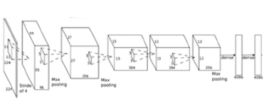
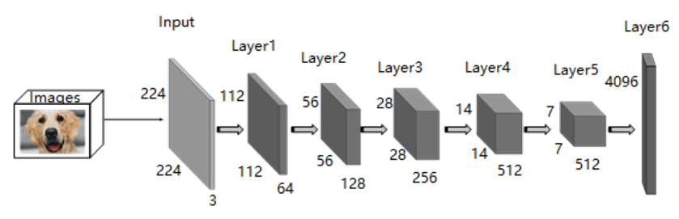
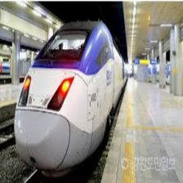
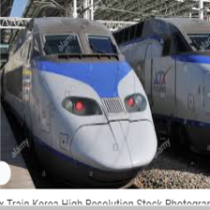
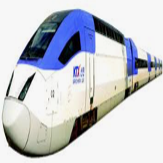
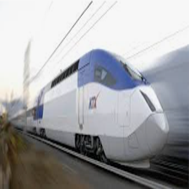

Combining CNN and one class SVM
Feature Vector
Feature
learning
ResNet50
Image Set
Feature
transfer
Transferring
Parameters
(CNN Features)
Classifier
learning
One Class
One Class
SVM
Classifier
Extraction of high-level features

Slide 18
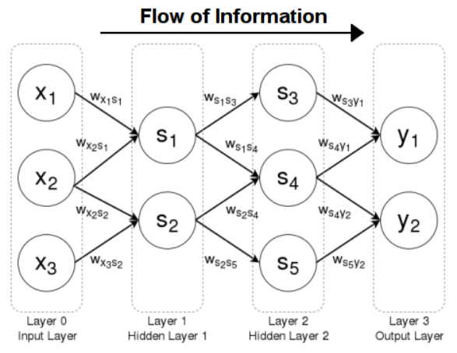
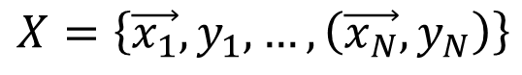
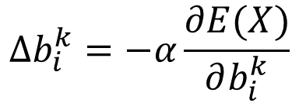
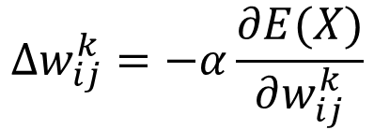
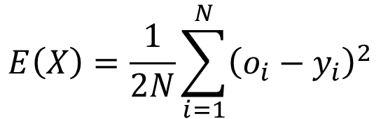
Fully connected Neural Network principal
$$X=\left\{\vec{x_{1}},y_{1},…,\left(\vec{x_{N}},y_{N}\right)\right\}$$
$$E\left(X\right)=\frac{1}{2N}\sum_{i=1}^{N}{{\left(o_{i}−y_{i}\right)}^{2}}$$
$$∆w_{ij}^{k}=−α\frac{∂E(X)}{∂w_{ij}^{k}}$$
$$∆b_{i}^{k}=−α\frac{∂E(X)}{∂b_{i}^{k}}$$

Slide 19
OCSVM tendency

Slide 20
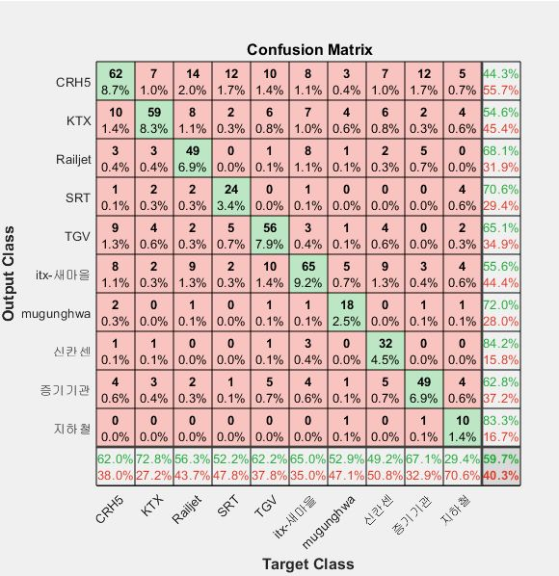
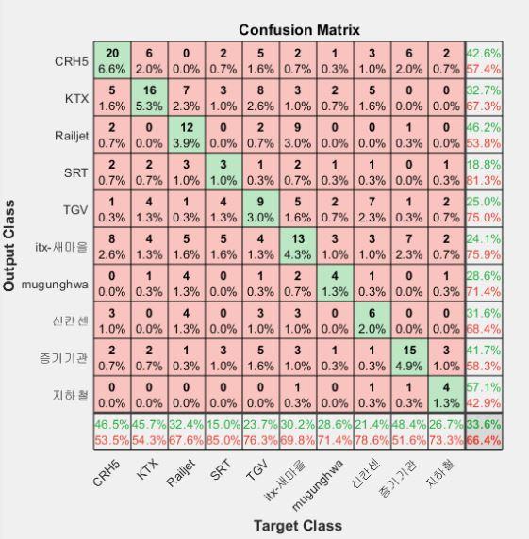
Result
Train
Test

Slide 21








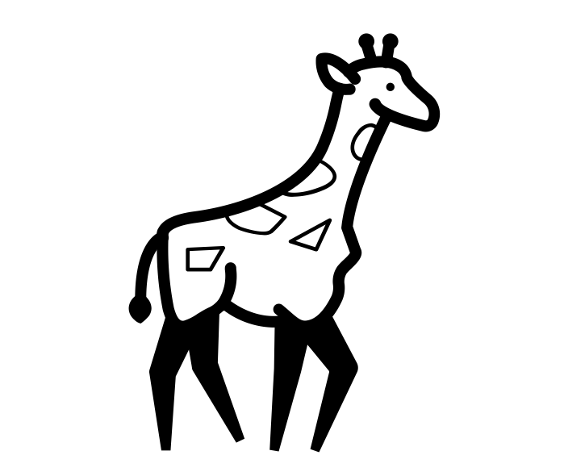


Conclusion
피쳐익스트랙션을 저차원(딥), 고차원(머신)으로 나누고 각 다른 방법론으로서 추출
저차원(딥러닝)
OCSVM
CNN
고차원(머신러닝)
MCSVM

Slide 22
Conclusion
비슷한 성능을 내지만 학습 및 예측 성능이 빠름

Slide 23
Conclusion
적은 클래스의 사전학습으로 많은 종류의 분류 가능

